Slide 1


Amazon S3 First look
Author: Khanh Nguyen
Month/Year

Slide 2


TABLE OF CONTENTS
01.
04.
06.
What is Amazon S3?
Presigned-url
Conclusion
02.
05.
07.
Main Concepts
Demo
Q&A
03.
Use cases

Slide 3


What is Amazon S3?

Slide 4

What is Amazon S3?
Amazon Simple Storage Service
Support for all use cases: data lakes, websites, backup and restore, archive, big data analytics
Ensure Availability and Durability
Notes:
AWS S3 là 1 dịch vụ lưu trữ dưới dạng object storage, cung cấp khả năng mở rộng, đảm bảo tính sẵn có của dữ liệu, bảo mật và hiệu suất hàng đầu trong ngành.

Slide 5
Main Concepts

Slide 6
Main Concept
How Amazon S3 works
S3 Versioning & Version ID
Bucket
Bucket Policy
Object
Access Control List
Keys
Region
Notes:
AWS S3 là 1 dịch vụ lưu trữ dưới dạng object storage, cung cấp khả năng mở rộng, đảm bảo tính sẵn có của dữ liệu, bảo mật và hiệu suất hàng đầu trong ngành.
Người dùng thuộc mọi quy mô và ngành nghề

Slide 7

How Amazon S3 works
Amazon S3 is an object storage service that stores data as objects within buckets.
An object is a file and any metadata that describes the file
A bucket is a container for objects.
Buckets and the objects in them are private

Slide 8

Bucket
Store any number of objects
Up to 100 buckets
Bucket name is globally unique
Enabled S3 Versioning
S3 Bucket

Slide 9

Objects
Fundamental entities stored in Amazon S3
Consist of object data and metadata
Uniquely identified within a bucket by a key (name) and a version ID
Notes:
The metadata is a set of name-value pairs that describe the object.
These pairs include some default metadata, such as the date last modified, and standard HTTP metadata, such as Content-Type.
You can also specify custom metadata at the time that the object is stored.

Slide 10
Keys
An object key (or key name) is the unique identifier for an object within a bucket
The combination of a bucket, object key, and optionally, version ID (if S3 Versioning is enabled for the bucket) uniquely identify each object
https://saigon-technology-react-node-bucket.s3.ap-southeast-1.amazonaws.com/photos/aws-s3.jpg

Slide 11

S3 Versioning & Version ID
Keep multiple variants of an object in the same bucket.
Preserve, retrieve, and restore every version of every object stored in your buckets
https://saigon-technology-react-node-bucket.s3.ap-southeast-1.amazonaws.com/photos/aws-s3.jpg?versionId=uy3tEPM5GfiApxOwCniSVmkz9uZdG1aL

Slide 12

Bucket policy
Policy that you can use to grant access permissions to your bucket and the objects in it.
You can use bucket policies to add or deny permissions for the objects in a bucket.

Slide 13
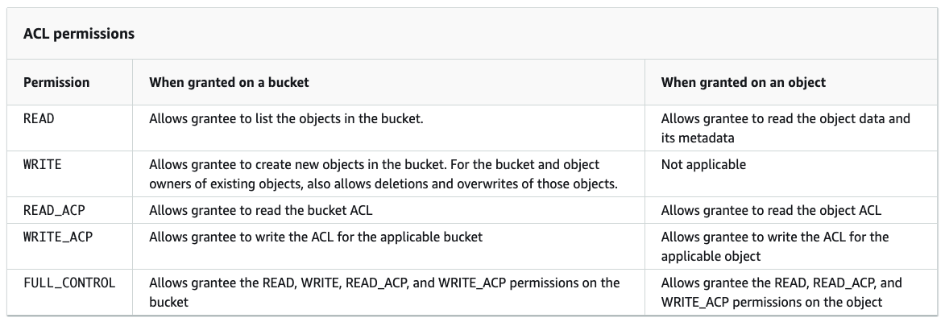
Access Control Lists (ACLs)
Grant read and write permissions to authorized users for individual buckets and objects
The ACL defines which AWS accounts or groups are granted access and the type of access.
A majority of modern use cases in Amazon S3 no longer require the use of ACLs.

Slide 14

Regions
You can choose the geographical AWS Region where Amazon S3 stores the buckets that you create.
Choose region to optimize latency, minimize costs, or address regulatory requirements

Slide 15
Use case

Slide 16
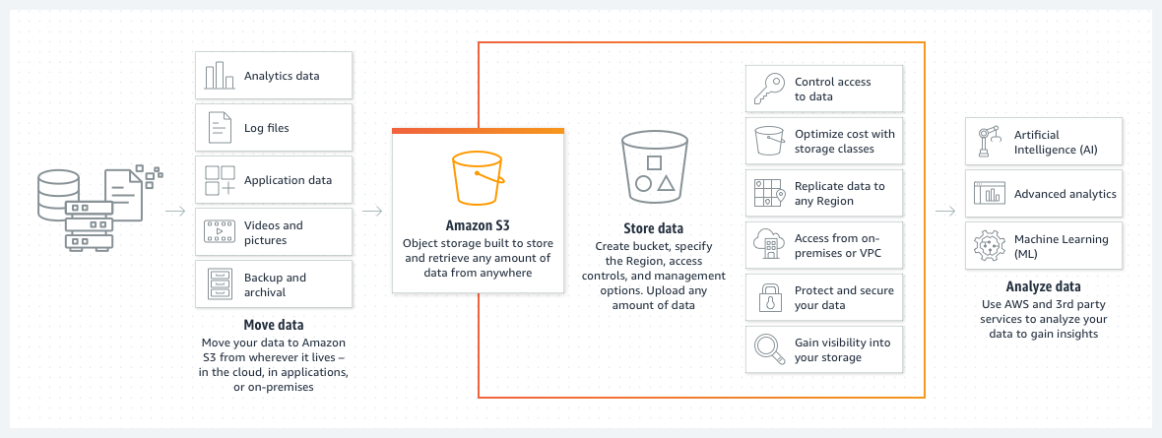
Use cases

Slide 17
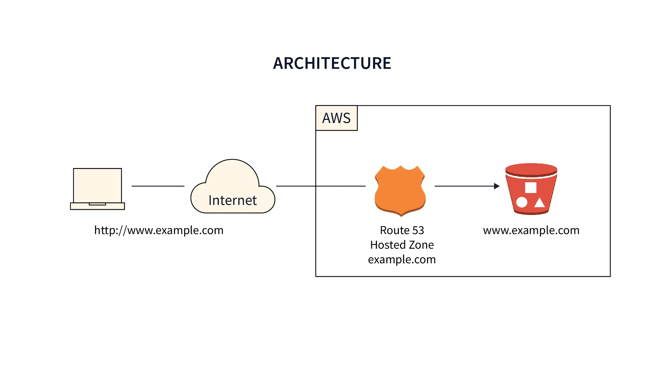
Use cases

Slide 18
Pre-signed url

Slide 19

Pre-signed url
All objects and buckets are private by default.
Presigned URL is used to optionally share objects or allow users to upload objects to buckets
Notes:
When you create a presigned URL, you associate it with a specific action. You can share the URL, and anyone with access to it can perform the action embedded in the URL as if they were the original signing user.

Slide 20
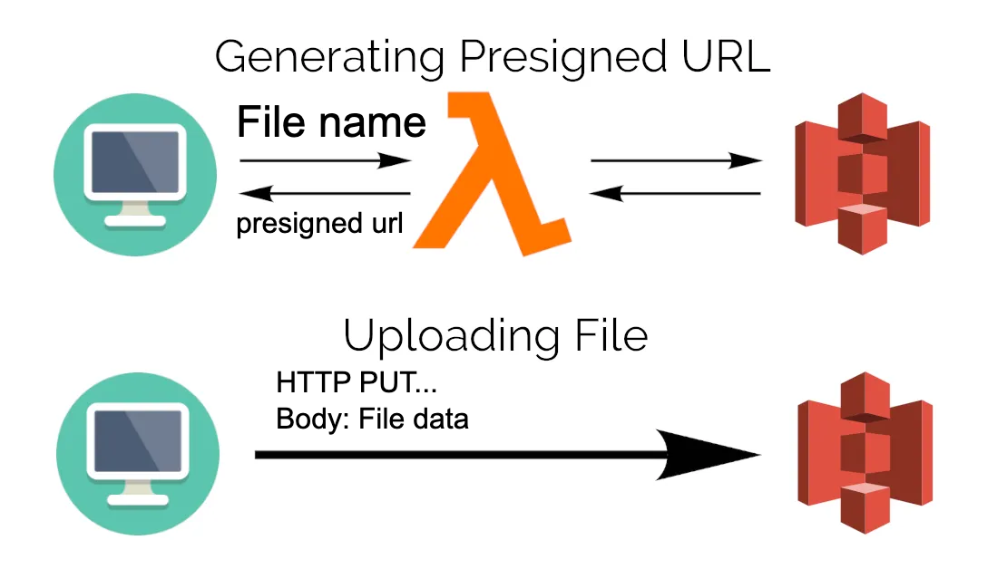
Upload file using pre-signed url
Notes:
When you create a presigned URL, you associate it with a specific action. You can share the URL, and anyone with access to it can perform the action embedded in the URL as if they were the original signing user.

Slide 21
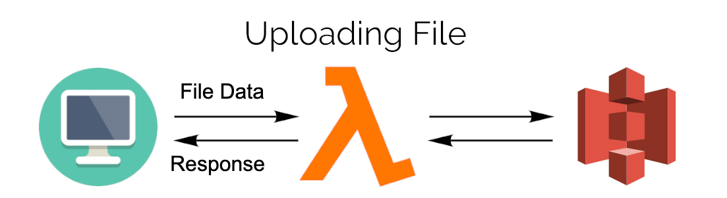
Upload file directly
Notes:
When you create a presigned URL, you associate it with a specific action. You can share the URL, and anyone with access to it can perform the action embedded in the URL as if they were the original signing user.

Slide 22
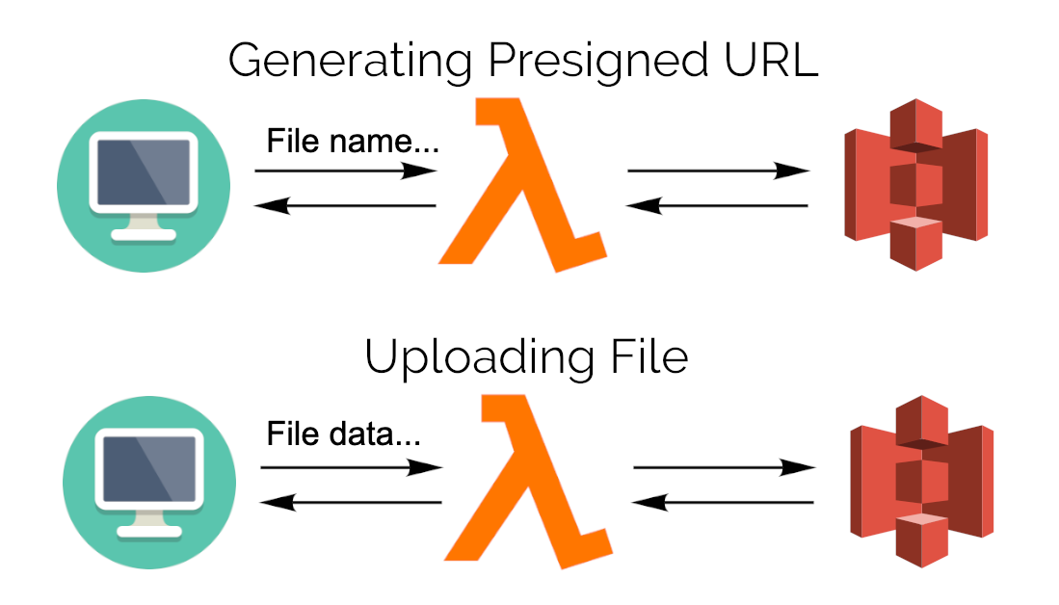
Deep compare
Notes:
When you create a presigned URL, you associate it with a specific action. You can share the URL, and anyone with access to it can perform the action embedded in the URL as if they were the original signing user.

Slide 23
Demo

Slide 24
Conclusion

Slide 25
Conclusion
Advantages | Disadvantages
Scalability | Data Transfer Costs
Durability and Reliability | API Complexity
Security | Eventual Consistency
Cost-effective | Object Size Limitations
Performance | Difficult Fully Understanding
Notes:
Scalability: S3 cho phép lưu trữ data ko giới hạn số lượng, với kích thước mỗi file lên tới 5TB/file.
Durability and Reliability: 99.999999999%, replicate data across multiple regions data centers
Security: S3 cung cấp các tính năng bảo mật hiện đại với access control policy, manage permissions và cơ chế encryption-decryption ở cả 2 phía server-side và client-side
Cost-effective: S3 tuân thủ theo nguyên tắc xài bao nhiêu trả bấy nhiêu, cho phép người dùng tối ưu chi phí với lượng data lưu trữ. Ngoài ra nó còn có các plan chart tiền khác nhau(đc gọi là storage classes) cho từng use case cụ thể.
Performance: low latency for retrieving data and supports parallel object downloads. Amazon S3 supports a request rate of 3,500 PUT, COPY, POST, DELETE or 5,500 GET, HEAD requests per second per prefix in a bucket.
Data Transfer Costs: Thông thường thì việc transfer data trong cùng 1 region là free, tuy nhiên nó sẽ tốn nhiều chi phí khi chúng ta transfer data sang region khác hoặc khi chúng ta transfer ra ngoài AWS.
API Complexity: Hơi khó để tiếp cận
Eventual Consistency: Đảm bảo dữ liệu nhất định sẽ nhất quán
Object Size Limitations: Dù có thể lưu trữ file tới 5 TB/file, nhưng S3 lại giới hạn 1 request PUT chỉ có thể upload tối đa 5GB. Do đó, muốn upload 1 file thực sự lớn thì chúng ta cần sử dụng multipart upload(thật ra thì AWS recommend sử dụng multipart upload cho file từ 100MB trở lên)
Difficult Fully Understanding: Với rất nhiều định nghĩa về bucket policy cũng như các storage classes, access control… Rất khó để có thể master và thành thạo AWS.

Slide 26
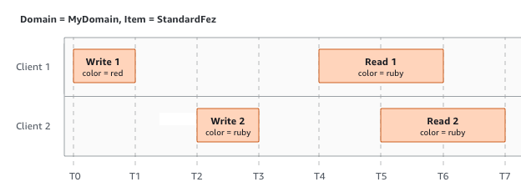
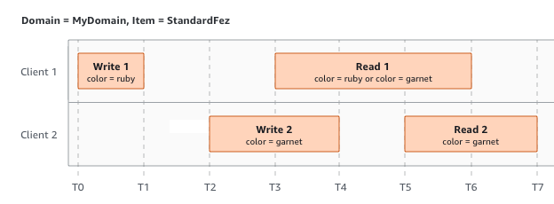
Eventual Consistency

Slide 27
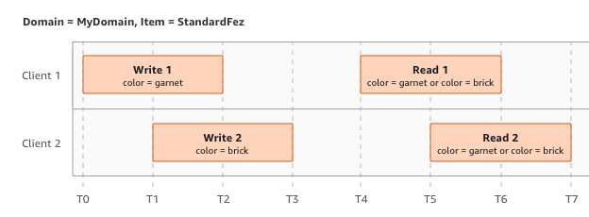
Eventual Consistency

Slide 28
Q & A

Slide 29

THANK YOU!

